Slide 1
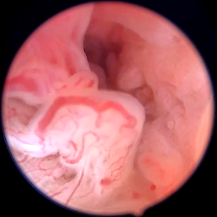
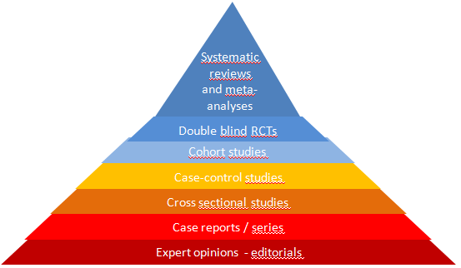
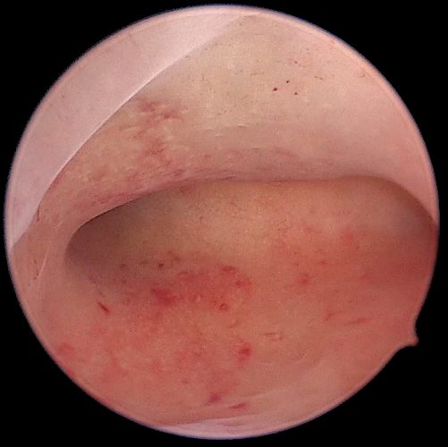
Evidence-based facts to consider for an optimal practice of hysteroscopy in symptomatic patients
Amal Drizi, M.D
Independent consultant in obstetrics and gynecology
Algiers; Algeria.
5th Minimally Invasive Gynecologic Surgery Congress 2022

Slide 2
No conflicts of interest to disclose
Notes:
First, we recall the current recommendations of investigating an infertile couple

Slide 3
WHAT IS EMB?
WHAT IS EMB (Evidence Based Medicine) ?

Slide 4
WHAT IS EMB?
WHAT IS EMB (Evidence Based Medicine) ?

Slide 5
WHAT IS EMB?
WHAT IS EMB (Evidence Based Medicine) ?
Cross sectional studies
OBSERVATIONAL STUDY
Case reports / series

Slide 6
WHAT IS EMB?
WHAT IS EMB (Evidence Based Medicine) ?
Cross sectional studies
OBSERVATIONAL STUDY
Case reports / series

Slide 7
WHAT IS EMB?
WHAT IS EMB (Evidence Based Medicine) ?
Case-control studies
Cross sectional studies
OBSERVATIONAL STUDY
Case reports / series

Slide 8
WHAT IS EMB?
WHAT IS EMB (Evidence Based Medicine) ?
Randomize sugar and stones
Case-control studies
Cross sectional studies
OBSERVATIONAL STUDY
Case reports / series

Slide 9
WHAT IS EMB?
WHAT IS EMB (Evidence Based Medicine) ?
Randomize sugar and stones
Double blind RCTs
Case-control studies
Cross sectional studies
OBSERVATIONAL STUDY
Case reports / series

Slide 10
WHAT IS EMB?
WHAT IS EMB (Evidence Based Medicine) ?
Methodologically analyse all the experiments done with sugar and stones in the world
Double blind RCTs
Case-control studies
Cross sectional studies
OBSERVATIONAL STUDY
Case reports / series

Slide 11
WHAT IS EMB?
WHAT IS EMB (Evidence Based Medicine) ?
Systematic reviews and meta-analyses
Methodologically analyse all the experiments done with sugar and stones in the world
Double blind RCTs
Case-control studies
Cross sectional studies
OBSERVATIONAL STUDY
Case reports / series

Slide 12
WHAT IS EMB (Evidence Based Medicine) ?
WHAT IS THE CURRENT BEST EVIDENCE?
Higher
THE PYRAMID OF EVIDENCE
Systematic reviews and meta-analyses
Double blind RCTs
Cohort studies
Level of evidence
Case-control studies
Cross sectional studies
OBSERVATIONAL STUDY
Case reports / series
Expert opinions - editorials
Lower

Slide 13
WHAT IS EMB (Evidence Based Medicine) ?
WHAT IS THE CURRENT BEST EVIDENCE?
Higher
THE PYRAMID OF EVIDENCE
Systematic reviews and meta-analyses
Systematic reviews of RCT = highest quality evidence
Double blind RCTs
Cohort studies
Level of evidence
Case-control studies
Cross sectional studies
OBSERVATIONAL STUDY
Case reports / series
Expert opinions - editorials
Lower

Slide 14
WHAT IS EMB (Evidence Based Medicine) ?
WHAT IS THE CURRENT BEST EVIDENCE?
Higher
Systematic reviews and meta-analyses
THE PYRAMID OF EVIDENCE
I just know
Systematic reviews of RCT = highest quality evidence
Double blind RCTs
Cohort studies
Level of evidence
Case-control studies
Cross sectional studies
OBSERVATIONAL STUDY
Case reports / series
Expert opinions - editorials
Lower

Slide 15
WHAT IS EMB (Evidence Based Medicine) ?
WHAT IS THE CURRENT BEST EVIDENCE?
Higher
Systematic reviews and meta-analyses
I just know
THE PYRAMID OF EVIDENCE
Systematic reviews of RCT = highest quality evidence
Double blind RCTs
Cohort studies
Level of evidence
Case-control studies
Cross sectional studies
OBSERVATIONAL STUDY
Case reports / series
Expert opinions - editorials
Lower

Slide 16
WHAT IS THE CURRENT BEST EVIDENCE?
Higher
THE PYRAMID OF EVIDENCE
Systematic reviews and meta-analyses
Could be any of these…
Double blind RCTs
Cohort studies
Level of evidence
Case-control studies
Cross sectional studies
OBSERVATIONAL STUDY
Case reports / series
Expert opinions - editorials
Lower

Slide 17
WHAT IS THE CURRENT BEST EVIDENCE?
Higher
THE PYRAMID OF EVIDENCE
Systematic reviews and meta-analyses
Double blind RCTs
Cohort studies
Level of evidence
Case-control studies
Cross sectional studies
OBSERVATIONAL STUDY
Case reports / series
Expert opinions - editorials
Lower

Slide 18
WHAT IS THE CURRENT BEST EVIDENCE?
WHAT IS THE CURRENT BEST EVIDENCE?

Slide 19
WHAT IS THE CURRENT BEST EVIDENCE?

Slide 20
WHAT IS THE CURRENT BEST EVIDENCE?

Slide 21
WHAT IS THE CURRENT BEST EVIDENCE?
Higher
THE PYRAMID OF EVIDENCE
Systematic reviews and meta-analyses
Could be any of these…
We’ll explain more however for now..
Double blind RCTs
Cohort studies
Level of evidence
Case-control studies
Cross sectional studies
OBSERVATIONAL STUDY
Case reports / series
Expert opinions - editorials
Lower

Slide 22
WHAT IS THE CURRENT BEST EVIDENCE?

Slide 23
WHAT IS THE CURRENT BEST EVIDENCE?
Higher
THE PYRAMID OF EVIDENCE
Systematic reviews and meta-analyses
Could be any of these…
We’ll explain more however for now..
Double blind RCTs
Cohort studies
Level of evidence
Case-control studies
Cross sectional studies
OBSERVATIONAL STUDY
Case reports / series
Expert opinions - editorials
Lower

Slide 24
WHAT IS THE CURRENT BEST EVIDENCE?

Slide 25
WHAT IS THE CURRENT BEST EVIDENCE?

Slide 26
WHAT IS THE CURRENT BEST EVIDENCE?

Slide 27
WHAT IS THE CURRENT BEST EVIDENCE?

Slide 28
What about symptomatic patients?

Slide 29
The patient’s complaints…
Subfertility
Abnormal Uterine Bleeding (AUB)

Slide 30
The patient’s complaint…
Abnormal Uterine Bleeding (AUB)

Slide 32
PALM -COEIN

Slide 33
PALM -COEIN

Slide 34
PALM -COEIN

Slide 35
PALM -COEIN

Slide 36
PALM -COEIN

Slide 37
PALM -COEIN

Slide 38
PALM -COEIN

Slide 39
PALM -COEIN

Slide 40
PALM -COEIN

Slide 41
PALM -COEIN

Slide 42
PALM -COEIN

Slide 43
An example about using EBM for a better hysteroscopy in symptomatic patients?

Slide 44
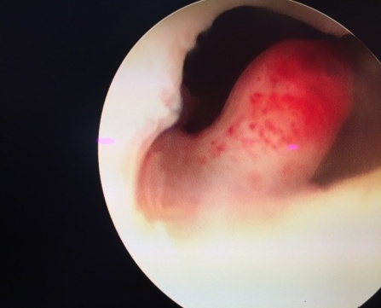
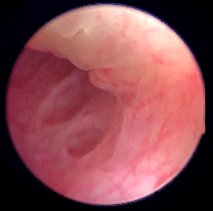
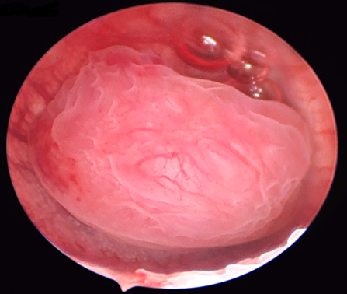
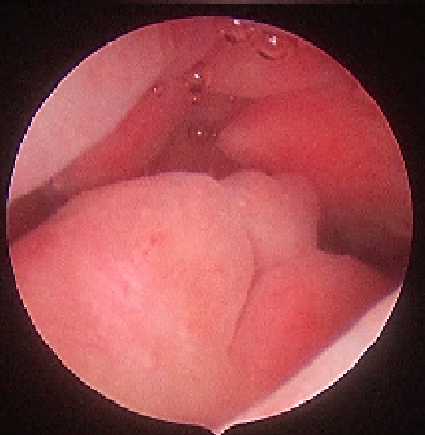
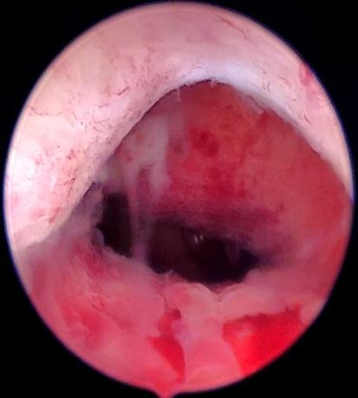
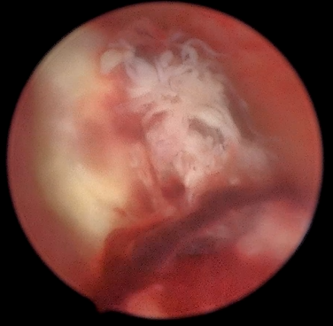
A. Drizi
A. Drizi
A. Drizi
PALM -COEIN
A. Drizi
A. Drizi
Isthmocele
RPOC
A. Drizi
A. Drizi

Slide 45
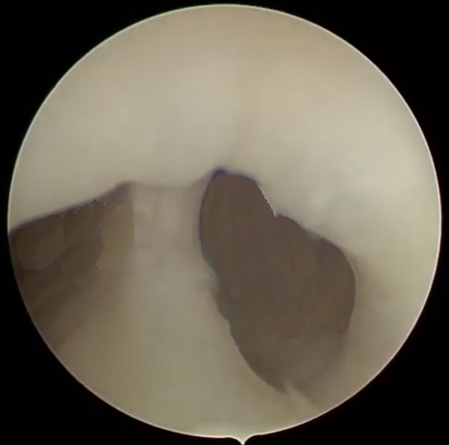
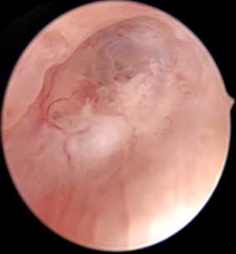
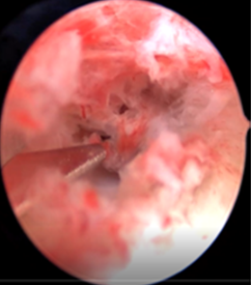
SUBFERTILITY
Malformations
A. Drizi
A. Drizi
A. Drizi
Synechia
A. Drizi
A. Drizi
A. Drizi
PALM -COEIN
A. Drizi
A. Drizi
Isthmocele
RPOC
A. Drizi
A. Drizi

Slide 46
SUBFERTILITY
Malformations
A. Drizi
A. Drizi
A. Drizi
Synechia
A. Drizi
A. Drizi
A. Drizi
PALM -COEIN
A. Drizi
A. Drizi
Isthmocele
RPOC
A. Drizi
A. Drizi

Slide 47
SUBFERTILITY
Malformations
A. Drizi
A. Drizi
A. Drizi
Synechia
A. Drizi
A. Drizi
A. Drizi
PALM -COEIN
A. Drizi
A. Drizi
Isthmocele
RPOC
A. Drizi
A. Drizi

Slide 48
PALM -COEIN

Slide 49
Inflammatory disorders
PALM -COEIN

Slide 50
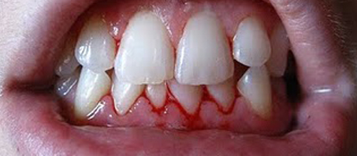
Gengivitis : blood on teeth picture
Algerie1.com

Slide 51
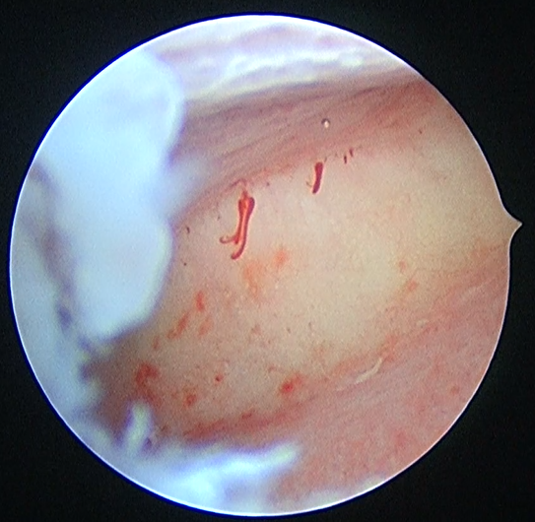
Spontaneous bleeding

Slide 52
WHAT IS THE CURRENT BEST EVIDENCE in this area?
Spontaneous bleeding
Inflammatory disorders

Slide 53
Definitions
Germs / plasma cells
Chronic endometritis
Gold standard : antibiotic therapy
Notes:
First, we recall the current recommendations of investigating an infertile couple

Slide 54
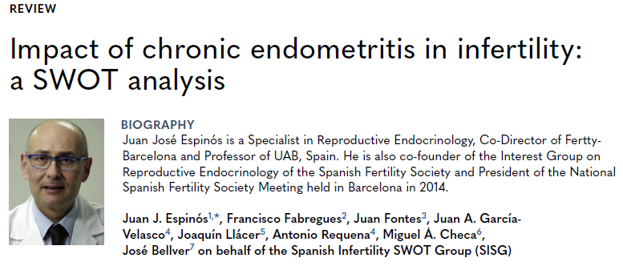

Slide 58
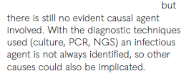

Slide 60
The first RCT about CE

Slide 63
Higher
THE PYRAMID OF EVIDENCE
Systematic reviews and meta-analyses
RCTs: not supporting germs and effectiveness of ATB
Double blind RCTs
Cohort studies
Level of evidence
Case-control studies
Cross sectional studies
OBSERVATIONAL STUDY
Case reports / series
Expert opinions - editorials
Lower

Slide 64
Systematic reviews and meta analyses: NO RCTs!

Slide 65
Systematic reviews and meta analyses: NO RCTs!

Slide 66
Higher
THE PYRAMID OF EVIDENCE
Systematic reviews and meta-analyses
The best possible available evidence
Double blind RCTs
Cohort studies
Level of evidence
Case-control studies
Cross sectional studies
OBSERVATIONAL STUDY
Case reports / series
Expert opinions - editorials
Lower

Slide 67
A new concept
Impaired Inflammatory State of the Endometrium (IISE)
Chronic endometritis (CE) : multiple weaknesses and limits!
Notes:
First, we recall the current recommendations of investigating an infertile couple

Slide 68
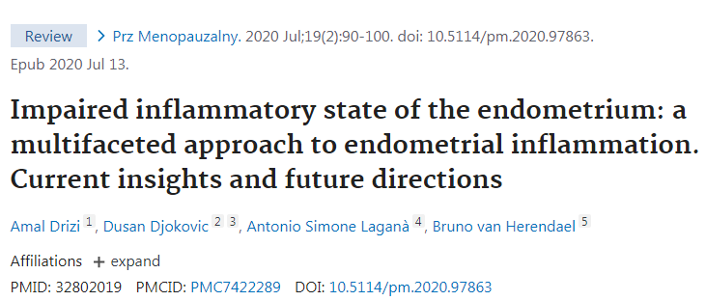
A new concept
Impaired Inflammatory State of the Endometrium (IISE)
Notes:
First, we recall the current recommendations of investigating an infertile couple

Slide 69
A new concept
Impaired Inflammatory State of the Endometrium (IISE)
Evidence-based rethinking of endometrial inflammation starting from basic sciences
Notes:
First, we recall the current recommendations of investigating an infertile couple

Slide 70
Impaired Inflammatory State of the Endometrium (IISE)
Why « impaired »
And not «endometritis » or inflammation?
Notes:
First, we recall the current recommendations of investigating an infertile couple

Slide 71
Impaired Inflammatory State of the Endometrium (IISE)
Why « impaired »
And not «endometritis » or inflammation?
A lot of works/ evidence: endometrial inflammation = essential physiological component
Notes:
First, we recall the current recommendations of investigating an infertile couple

Slide 72
Endometritis or endometrial inflammation is the basis of endometrial physiology

Slide 73
Endometritis or endometrial inflammation is the basis of endometrial physiology

Slide 74
Endometritis or endometrial inflammation is the basis of endometrial physiology

Slide 75
Endometritis or endometrial inflammation is the basis of endometrial physiology

Slide 76
Endometritis or endometrial inflammation is the basis of endometrial physiology

Slide 77
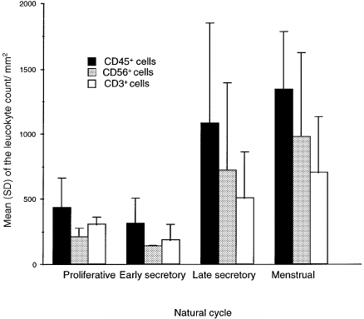

Slide 78
WHAT IS THE CURRENT BEST EVIDENCE?

Slide 79
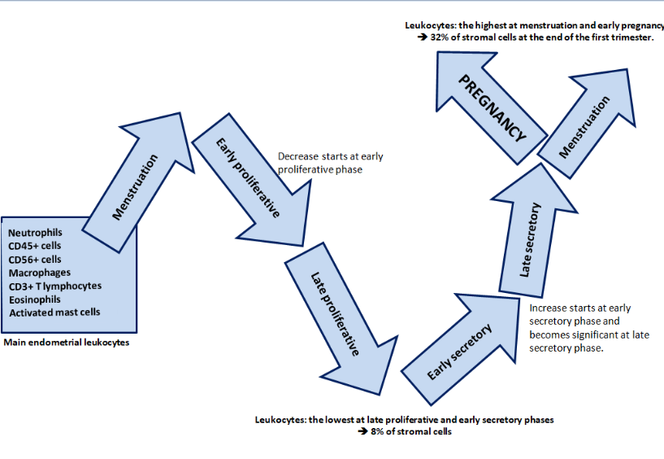
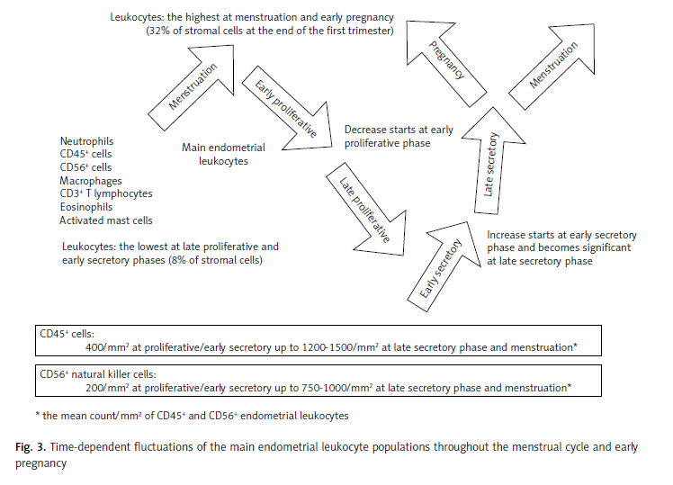
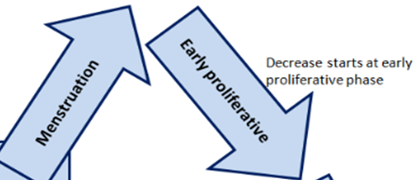
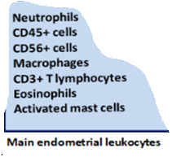
Normal endometrium already in a chronic well balanced inflammatory state!
Different cells and cytokines, different pathways
Basic concepts…
The inflammatory cells involved in the endometrium
Time-dependent fluctuations of the main endometrial leukocyte populations throughout the menstrual cycle and early pregnancy.
Drizi et al. Menopause Review/Przegląd Menopauzalny 19(2) 2020

Slide 80
Drizi et al. Menopause Review/Przegląd Menopauzalny 19(2) 2020
EXCESS of inflammation
=
PROBLEM

Slide 81
Drizi et al. Menopause Review/Przegląd Menopauzalny 19(2) 2020
EXCESS of inflammation
=
PROBLEM
SUPRESSION of inflammation
=
PROBLEM

Slide 82
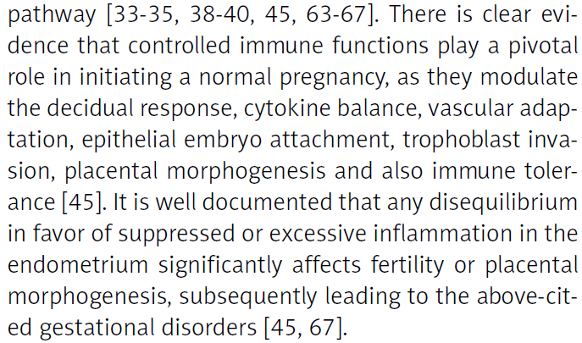

Slide 84
Drizi et al. Menopause Review/Przegląd Menopauzalny 19(2) 2020
EXCESS of inflammation
=
PROBLEM
SUPRESSION of inflammation
=
PROBLEM
IMPAIRED INFLAMMATORY STATE OF THE ENDOMETRIUM: more proper terminology

Slide 85
Not only germs+++ = basics of immunology and endometrial physiology!

Slide 86
Not only germs+++ = basics of immunology and endometrial physiology!
Stress
Hormone imbalances
Auto-imm, allergic and inflam. conditions.
Semen induced Infl. /allergy
High doses
anti-inflammatory drugs
Endometriosis
Adenomyosis
Diabetes, dyslipidemia, obesity and hypertension
MTB disorders
Oxidative stress
Age, toxic habits, pollution, allergies and sleep disorders,…

Slide 87
Diagnostic hysteroscopy

Slide 88
Diagnostic hysteroscopy
Need to correct some wrong ideas: in violation with the basics of immunology and physiology…

Slide 89
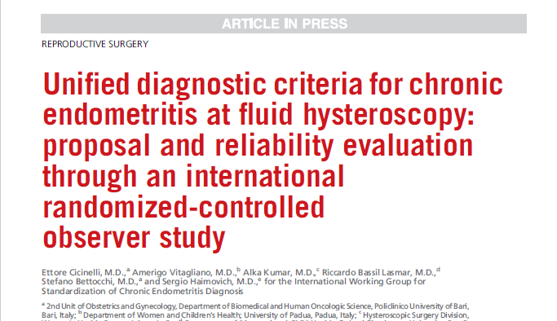
Diagnostic hysteroscopy

Slide 90
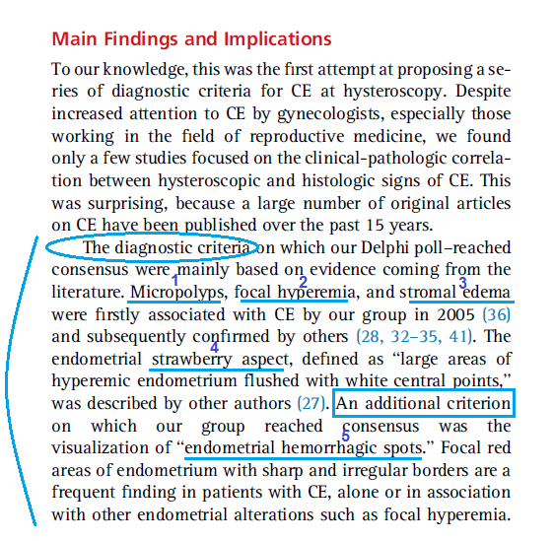
Diagnostic hysteroscopy

Slide 91
WHAT IS THE CURRENT BEST EVIDENCE?

Slide 92
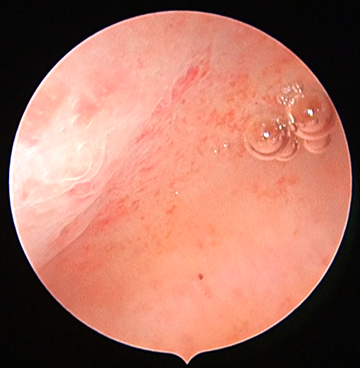
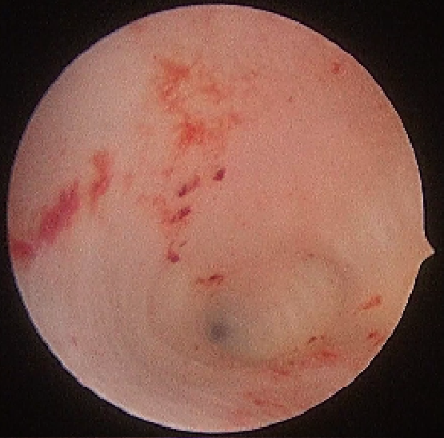
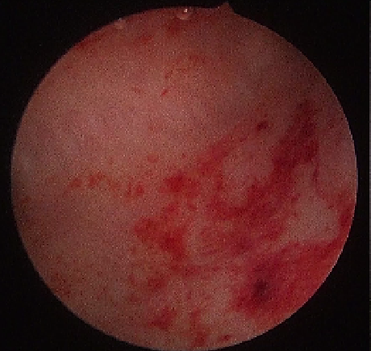
Diagnostic hysteroscopy
Basics of immunology : redness, & edema are cardinal signs of ACUTE inflammation
Since the era before Christ.
Edema
⬅hemorrhagic spots
Hyperemia
A. Drizi
A. Drizi
⬅hemorr-hagic spot
A. Drizi

Slide 93
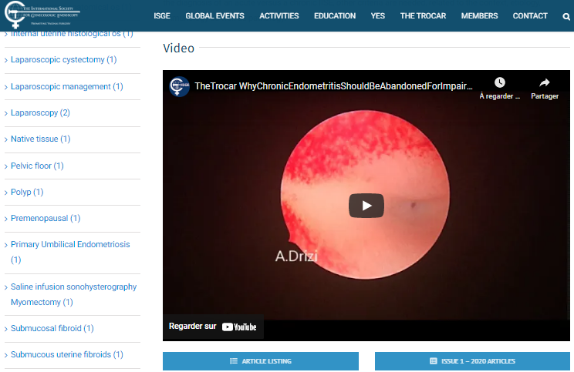
Diagnostic hysteroscopy
Basics of immunology : redness, hemorrhagic spots & edema are cardinal signs of acute inflammation, not the chronic one!
Unfortunately, to date: described as signs of CE in hysteroscopy guidelines!
Edema
⬅hemorrhagic spots
Hyperemia
A. Drizi
A. Drizi
A. Drizi

Slide 94
Diagnostic hysteroscopy

Slide 95
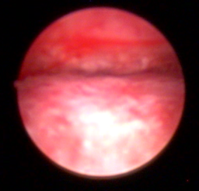
Diagnostic hysteroscopy
Important endometrial edema at the end of hysteroscopy

Slide 96
Diagnostic hysteroscopy
Practical implications:
Signs of acute inflammation within the endometrium like swelling and redness are NOT ENOUGH to ascertain a chronic inflammatory disorder:
transient IISE
ACUTE LESION in the context of a REPEATED or PERSISTENT IISE

Slide 97
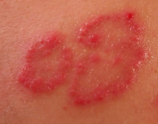
Diagnostic hysteroscopy
Just like in dermatology…

Slide 98
Diagnostic hysteroscopy
Just like in dermatology…
PSORIASIS

Slide 99
Diagnostic hysteroscopy
Practical implications:
Signs of acute inflammation within the endometrium like swelling and redness are NOT ENOUGH to ascertain a chronic inflammatory disorder:
transient IISE
ACUTE LESION in the context of a REPEATED or PERSISTENT IISE
Always judge inflammation at the very first passage of the scope

Slide 100
Diagnostic hysteroscopy
How to make the difference between transient and chronic disorder?

Slide 101
Diagnostic hysteroscopy
How to make the difference between transient and chronic disorder?
ADDITIONAL CRITERIA ARE NEEDED for chronic disorder
Micropolyps

Slide 102
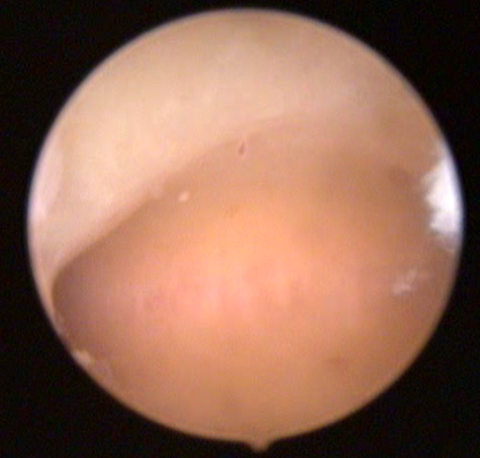
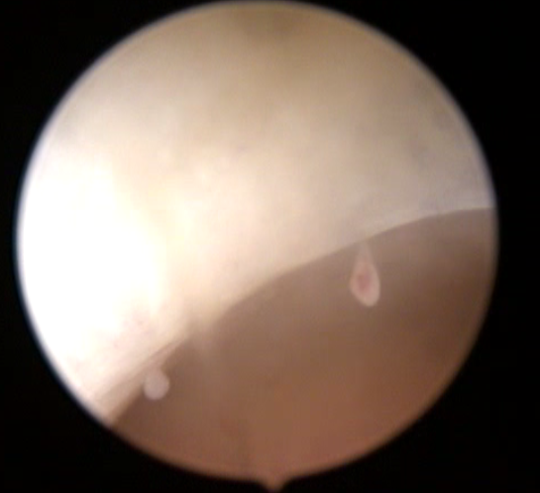
Diagnostic hysteroscopy
MICROPOLYPS
How to make the difference between transient and chronic disorder?
ADDITIONAL CRITERIA ARE NEEDED for chronic disorder
Micropolyps
Other hysteroscopic criteria we are currently working on

Slide 103
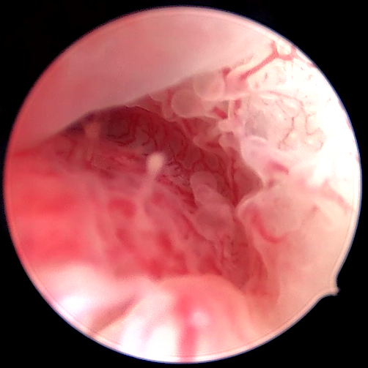
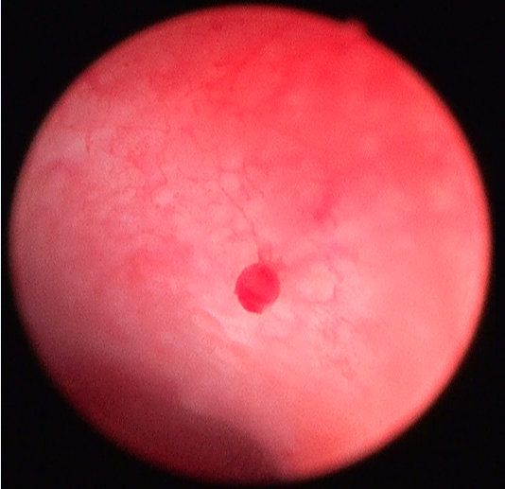
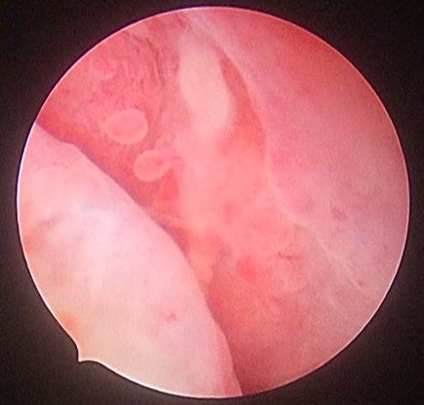
Diagnostic hysteroscopy
MICROPOLYPS
How to make the difference between transient and chronic disorder?
ADDITIONAL CRITERIA ARE NEEDED for chronic disorder
Micropolyps
Other hysteroscopic criteria we are currently working on
A. Drizi
A. Drizi
A. Drizi

Slide 104
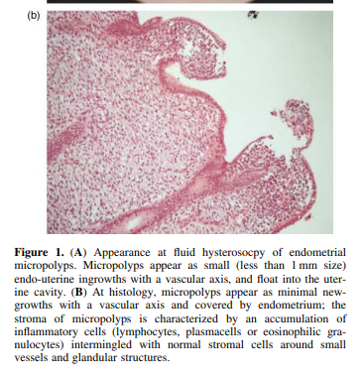
Diagnostic hysteroscopy
MICROPOLYPS
How to make the difference between transient and chronic disorder?
ADDITIONAL CRITERIA ARE NEEDED for chronic disorder
Micropolyps
Other hysteroscopic criteria we are currently working on
A. Drizi
A. Drizi
A. Drizi

Slide 105
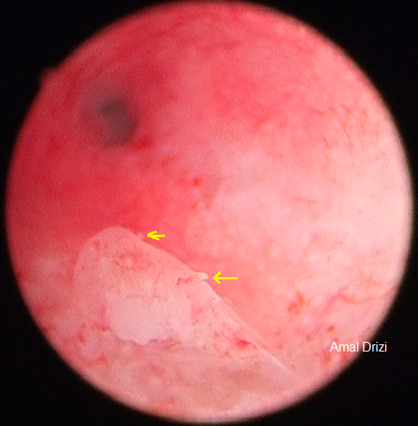
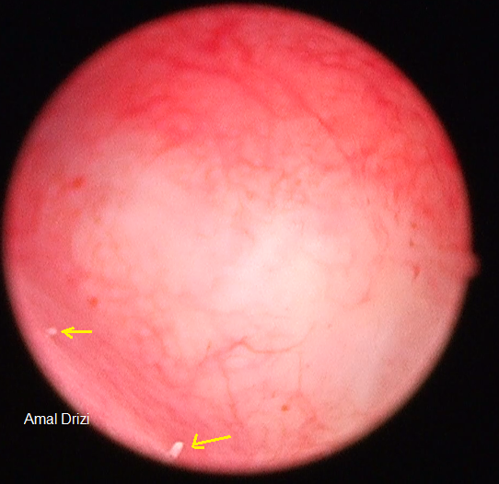
Diagnostic hysteroscopy
The biopsy should be performed within the site of the inflammatory lesions

Slide 106
Diagnostic hysteroscopy
How to make the difference between transient and chronic disorder?
ADDITIONAL CRITERIA ARE NEEDED for chronic disorder
Micropolyps
Other hysteroscopic criteria we are currently working on

Slide 107
Diagnostic hysteroscopy
How to make the difference between transient and chronic disorder?
ADDITIONAL CRITERIA ARE NEEDED for chronic disorder
Micropolyps
Other hysteroscopic criteria we are currently working on
To be continued…

Slide 108
Conclusion…
EVIDENCE BASE THINKING +++
All questions related to our practice

Slide 109
WHAT IS EMB?
WHAT IS EMB? FINAL TEST
Systematic reviews and meta-analyses
Methodologically analyse all the experiments done with sugar and stones in the world
Double blind RCTs
Case-control studies
Cross sectional studies
OBSERVATIONAL STUDY
Case reports / series

Slide 110
WHAT IS EMB?
WHAT IS EMB (Evidence Based Medicine) ?
Higher
THE PYRAMID OF EVIDENCE
Systematic reviews and meta-analyses
Sugar in a cup of hot tea with a bunch of mint
And enjoy it....
Double blind RCTs
Cohort studies
Level of evidence
Case-control studies
Cross sectional studies
OBSERVATIONAL STUDY
Case reports / series
Expert opinions - editorials
Lower

Slide 111
WHAT IS EMB?
WHAT IS EMB (Evidence Based Medicine) ?
Higher
THE PYRAMID OF EVIDENCE
Systematic reviews and meta-analyses
Sugar in a cup of hot tea with a bunch of mint
And enjoy it....
Double blind RCTs
Cohort studies
Level of evidence
Case-control studies
Clinical practice principled on EBM
Cross sectional studies
OBSERVATIONAL STUDY
Case reports / series
Expert opinions - editorials
Lower

Slide 112
Thank you for your attention

