Slide 1
Preoperative Evaluation of the Endometriotic Patients Combining US & #Enzian
5th MINIMALLY INVASIVE GYNECOLOGIC SURGERY CONGRESS
February 23 – 26, 2022, Istanbul, Turkey
Dusan Djokovic
Vision without action is a daydream.
Action without a vision is a nightmare.

Slide 2
Introduction
US: 1st line imaging tool in patients with suspected / known endometriosis
Advanced centers: Sn & Sp of US ≈ MRI for DIE, may exceed 80 – 90%
(Mattos 2019, Indrielle-Kelly 2020, Zhang 2020)
Expert US and MRI: highly useful alternatives to laparoscopy
(Zhang 2020)
Notes:
Ultrasound (US) represents the first-line imaging tool in patients with symptoms and signs of endometriosis.
In advanced centers, sensitivity and specificity of US for DIE, such as the sensitivity and specificity of magnetic resonance imaging (MRI), may exceed 80 – 90%, making these techniques highly useful alternatives to laparoscopy.

Slide 3
Introduction

Slide 4
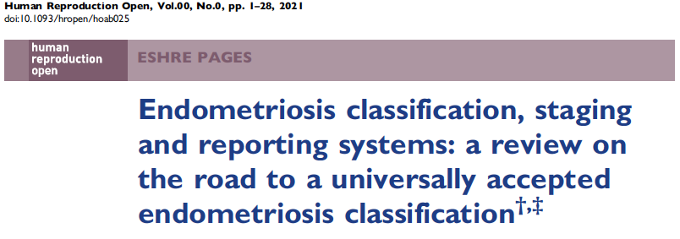
Introduction

Slide 5
Introduction
SEF | Enzian classification (2003, 2005; revision 2011):
A valid tool for classifying DIE in both US/MRI and surgical settings
(Haas 2011, Haas 2013, Keckstein 2021, Lee 2021, Hudelist 2021)
Recommended by ISGE, ESGE, ESHRE, WES, CONSORT, German, Swiss, Czech &
Austrian Societies for Ob/Gyn (Ulrich 2014, Vanhie 2016, Johnson 2017, Keckstein 2019, Djokovic 2021)
The newly modified #Enzian (2021):
Peritoneal, ovarian endometriosis & the extent of adnexal adhesion included
(Keckstein 2021)
Notes:
The Enzian classification was evaluated in several clinical studies during the last decade and recognized as a valid and suitable tool for the classification of DIE in both US/MRI and surgical settings . Many international and national societies have recommended the Enzian classification to be used for classification of DIE [24]. The newly modified #Enzian (2021) now also includes the peritoneal and ovarian endometriosis, and the extent of adnexal adhesions [18] and can be used for non-invasive and surgical procedures.

Slide 6
Outlines
Standardized, comprehensive and systematic US evaluation and reporting
of endometriosis in pelvic structures, in correlation with the #Enzian
The ISGE 2021 recommendations for structured reporting of the findings
obtained by dynamic US assessment of endometriotic patients
Notes:
This talk serves:
- to promote the practice of standardized, comprehensive and systematic US evaluation and reporting of endometriosis in pelvic structures, in correlation with the #Enzian classification.
The ISGE 2021 recommendations for reporting findings obtained by dynamic US assessment will also be presented

Slide 7
Standard lexicon and measurements
Notes:
To allow meaningful comparisons between studies, while promoting unambiguous communication among sonographers, radiologists,
gynecologists, surgeons and others clinicians, the International Deep Endometriosis Analysis Group (IDEA) provided a consensus statement on terms, definitions and measurements
that can be applied to describe the US characteristics of diferente endometriosis phenotypes.
As suggested by the IDEA , US scan should include 4 steps...

Slide 8
Standard lexicon and measurements
Expert US (IDEA protocol):
- The same accuracy as MRI in the detection of DIE in the
upper rectum, rectosigmoid and ureter
- Marginally higher Sp but lower Sn in the assessment of bladder,
USLs, vagina, rectovaginal septum and pelvic DIE overall
- No overall negative impact on the DIE detection rate
(Indrielle-Kelly 2020)
Notes:
Not oficial validation (reduced Nº of patientes)
In acordasse with a recently published work from Fisherova’s grouop, TVUS,
when performed by experienced operator and using the protocol
based on the IDEA consensus, has the same accuracy as MRI in
the detection of DIE in the upper rectum, rectosigmoid and ureter
while it has marginally higher specificity but lower sensitivity in
the assessment of bladder, USLs, vagina, rectovaginal septum and
pelvic DIE overall [10]. The IDEA nomenclature and measurements
do not have an overall negative impact on the DIE detection rate
[10].

Slide 9
Standard reporting and classification
Structured reporting
Improved surgical planning
(complex disease)
(Tuncyurek 2019, Mattos 2019)
Notes:
In addition to the standardized US technique, it is highly desirable to present the information
obtained during the examination within standardized, comprehensive but clear, well-structured reports, in order to facilitate the
patient counseling and management.
In comparison with narrative reporting, structured reporting has been found to improve surgica planning in patients with complex diseases [9,13

Slide 10
Standard reporting and classification
Enzian/#Enzian use:
High concordance between US & surgical dg.
(Hudelist 2021, Al 2021)
(Keckstein 2021)
Notes:
Recent studies show the high accuracy between sonographic and surgical diagnostics using the Enzian/#Enzian
The modified #Enzian classification does integrate the various parameters of the IDEA protocol.
Individual compartments/regions and organs are coded /symbolically marked with letters, P_, O_/_, T _/_, A _,
B_/_, C _, F(. . .) _ [P – peritoneal disease reliably documented only
during surgery, but not imaging procedures; O – ovarian
endometriosis; T – conditions affecting tubo-ovarian unit; A – DIE
affecting vagina, RVS and retrocervical space; B – DIE affecting
USL/cardinal ligament/pelvic sidewall; C - DIE affecting rectum; F
– affected so-called far locations including FA (adenomyosis), FB
(urinary bladder), FU (ureters), FI (intestine above the rectum,
i.e. > 16 cm from the anal verge) and F(. . .) (other extragenital
anatomical strictures which should be specified by the localization
in brackets; e.g. F (umbilicus)].
classification [25,26].

Slide 11
Development of the ISGE recommendations
The ISGE recommends:
Terms, definitions and methods proposed by the IDEA Group for US assessment of patients with suspected or known endometriosis as the most comprehensive and systematic concept currently available (grade 1C);
The #Enzian classification and coding to summarize the findings in a standard fashion (grade 1B).
Notes:
The ISGE recommends the adoption of the terms, definitions and methods proposed by the
International Deep Endometriosis Analysis (IDEA) Group for ultrasound assessment of patients with suspected
or known endometriosis (grade 1C), since this is the most comprehensive and systematic concept
currently available. This paper provides the ISGE structured reporting template for presenting quantitative
and qualitative information upon the IDEA consensus-based sonographic assessment of the uterus,
adnexa, anterior and posterior compartment. The #Enzian classification is recommended to summarize
the findings in a standard fashion (grade 1B).

Slide 12
1. General impression
Reis 2021
Notes:
The report of an US examination should provide clearly and logically organized information that explains the patient’s symptomatology by mapping the disease.
It is appropriate to initiate a US report with a general impression, stating or denying the existence of a ‘‘frozen” pelvis, which can be caused by endometriosis, but also by pathology other than endometriosis.

Slide 13
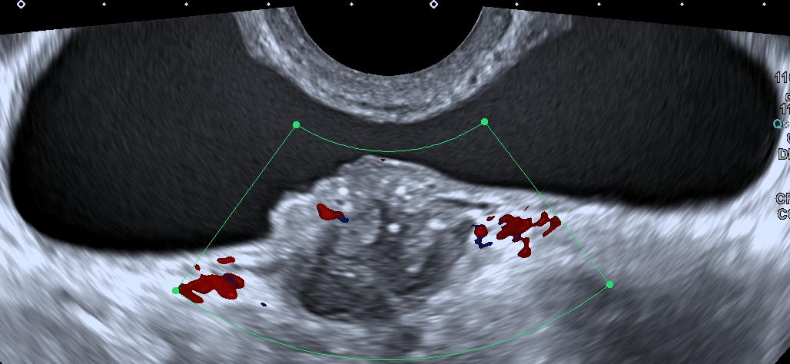
2. Anterior compartment
Djokovic 2021
Notes:
The endometriosis involvement of the pelvic structures, didactically divided into three compartments (anterior, mid – uterus and adnexae, and posterior compartment), should be then assessed and reported to guide the planning and implementation of medical and/or surgical treatment, as well as patient counseling during this process.
The anterior comp includes UVR that can be obliterated or non obliterated; UB ans Ureters – that can be normal or abnormal. Any lesion fo the UB or Us (coresponding to #E code FB and FU, respectively) should be reported with deteils, with surgically importante information presented in this slide. For exemple...

Slide 14
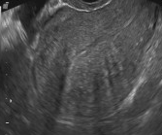
3. Mid compartment
S
Djokovic 2020
Definition refinements MUSA 2021
(UOG)
Notes:
Mid Comp includes uterus and adnexae. Terms, def and measurements sugested by MUSA group concensus are recommended. Partcular attention should be payed to the feturs suggesting adenomyosis – coded as FA in accordanece with #Enzian.

Slide 15
3. Mid compartment
S
Djokovic 2020
Notes:
For the assesment and the reporting of endometrial and intracavitary lesions, IETA concensus should be followed.

Slide 16
3. Mid compartment
Djokovic 2021
Notes:
IOTA
IOTA Models for the malignancy risk predictions
While edometriomas corespond to the Enzian O code, conditions affecting tubo-ovarian unit (namely, adhesions, impaired mobilty and tubal pathency) correspond to the Enzian code T.

Slide 17
4. Posterior compartment
Djokovic 2021
Djokovic 2021
Notes:
The anatomical structures of the posterior compartment are the most common sites of DIE.
The posterior compartment includes rectovaginal space, posterior vaginal fornix, retrocervical space, utero-sacral ligaments (USLs), cardinal ligaments, pelvic sidewall, rectum and pouch of
Douglas.
Iach structurte can be normal or abdnormal. If abdnormal, it should be reported with details of surgical relevance.

Slide 18
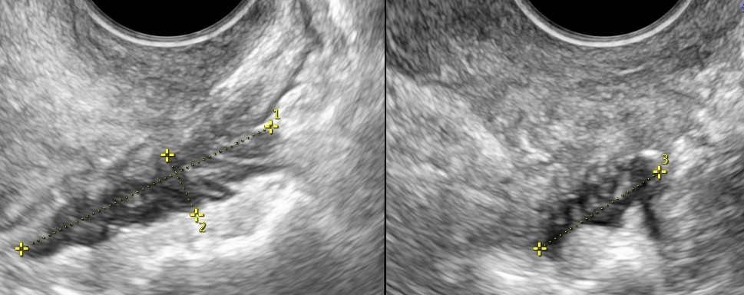
4. Posterior compartment
25 x 15 x 10 mm => #Enzian(u): C2
Reis 2021
Djokovic 2021
33 x 8 x 17 mm => #Enzian(u): C3
Notes:
For exemple, in the case of rectal abnormality: ...

Slide 19
5. Other extragenital lesions
Intestinal lesions above the rectum (> 16 cm from the anal verge) should be reported by analogy to the rectal DIE, #Emzian FI
Other locations (e.g., diaphragm and umbilicus) should be specified by the localization, lesion size and morphology, #Emzian F(………)
6. Site-specific tenderness
Notes:
Intestinal lesions above the rectum (i.e. those located above 16 cm from the anal verge) should be reported by analogy to the rectal DIE
Other locations (e.g., diaphragm and umbilicus) should be specified by the localization, lesion size and morphology.
The main strength of the US compared to MRI is that sonography allows pain to be provoked or worsened selectively in various anatomical structures during examination. Consequently, this
makes the decision-making process more reliable because it is
guided by the patient’s symptoms. All sites of tenderness experienced
by the patient during the examination should be reported.

Slide 20
Summary of report
#Emzian(u) code
(Keckstein 2021)
Notes:
In order to summarize the report and sonographic mapping of
diseases in a standard way, the #Enzian code shoud be provided.

Slide 21
Summary | Takeaway messages
Mapping of pelvic endometriosis by ultrasound is accurate when trained sonographers perform the technique.
Structured reporting of the lesions may improve patient counseling and treatment planning, including the organization of multidisciplinary teams and the selection of the most appropriate medical and/or surgical therapeutic strategy.
The ISGE template for the structured report is available.
Notes:
Mapping of pelvic endometriosis by ultrasound is accurate when trained sonographers perform the technique.
Structured reporting of the lesions may improve patient counseling and treatment planning, including the organization of multidisciplinary teams and the selection of the most appropriate medical or surgical therapeutic strategy.
The ISGE template for the structured report has been published and is available.

